Slide 1

Instagram Reels for Realtors®
Tips, Tricks, Trends and a Little How To! – October 2022

Slide 2


Brought to you by:
Class sponsored by:

Slide 3
What are Instagram Reels?
Instagram Reels are full-screen vertical videos that can be up to 90 seconds long. They come with many unique editing tools and an extensive library of audio tracks (featuring everything from trending songs to snippets of other users’ viral content).
On top of sounds, Reels can include multiple video clips, filters, captions, interactive backgrounds, stickers, and more.
Reels are different from Instagram Stories. Unlike Stories, they don’t disappear after 24 hours. Once you post a Reel, it’s available on Instagram until you delete it.

Slide 4
Why Instagram Reels?
Reels are currently favored by the Instagram algorithm, which is more likely to recommend them to people who don’t follow you other than on feed posts.
By using Instagram Reels, an account can increase its engagement rate up to 1.95% on average.
Helps spread awareness of your brand. With the average attention span being about eight seconds long, this form of video content is perfect for keeping the attention of targeted audiences.
When you create Reels, nine times out of ten, you’re probably going to be showing your face or a face in it. This allows you to showcase brand personality and humanize the brand all around.

Slide 5
Why Instagram Reels?
Reels are currently favored by the Instagram algorithm, which is more likely to recommend them to people who don’t follow you other than on feed posts.

Slide 6
That is huge for social marketers.
Hashtags are fading. Instagram is relying much more on their AI. The head of IG, Adam Mosseri has come out to confirm that the algorithm DOES NOT rely on hashtags anymore to categorize your content. Rather, it’s using:
• keywords found in your caption
• the text on the screen
• the verbal words you are speaking in your Reels
So, if your goal is to grow your account and reach more people, spend the extra time making sure your account is set up to be easily categorized while also making sure your keywords across your post are SEO optimized FOR your ideal follower.
Instagram Algorithm

Slide 7
Most Important Reels Algorithm Signals
Instagram says user activity is the most important signal when it comes to recommending Reels.
The algorithm considers which Reels a user has engaged with in the past, and whether they’ve had any direct interaction with the content creator.
That means responding to comments, DMs, and tags can help get your content shown in peoples’ feeds more often.
After that, Instagram looks at information about the video itself and information about the content creator.
The most important signals for the Reels recommendation algorithm are (in order of importance):
User activity: Including recent engagement with Reels and interactions with content creators.
Information about the Reel: Such as its popularity, its audio track, and understanding of the video based on pixels and whole frames.
Information about the creator: Including who they are and how other users have interacted with them.
Instagram Algorithm

Slide 8
Why Instagram Reels?
By using Instagram Reels, an account can increase its engagement rate up to 1.95% on average.

Slide 9
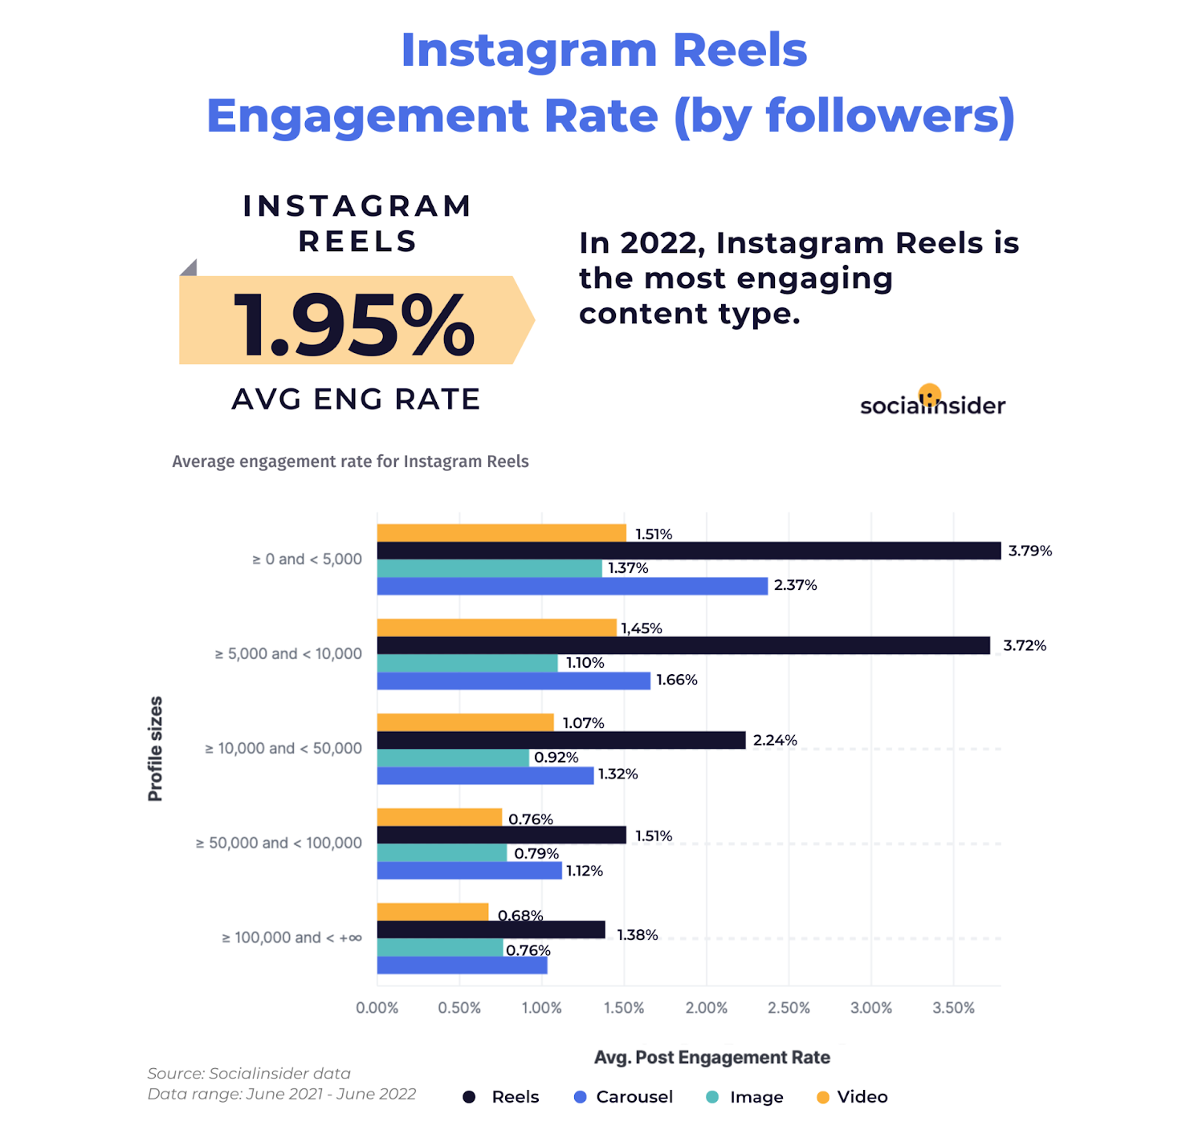
Instagram Engagement

Slide 10
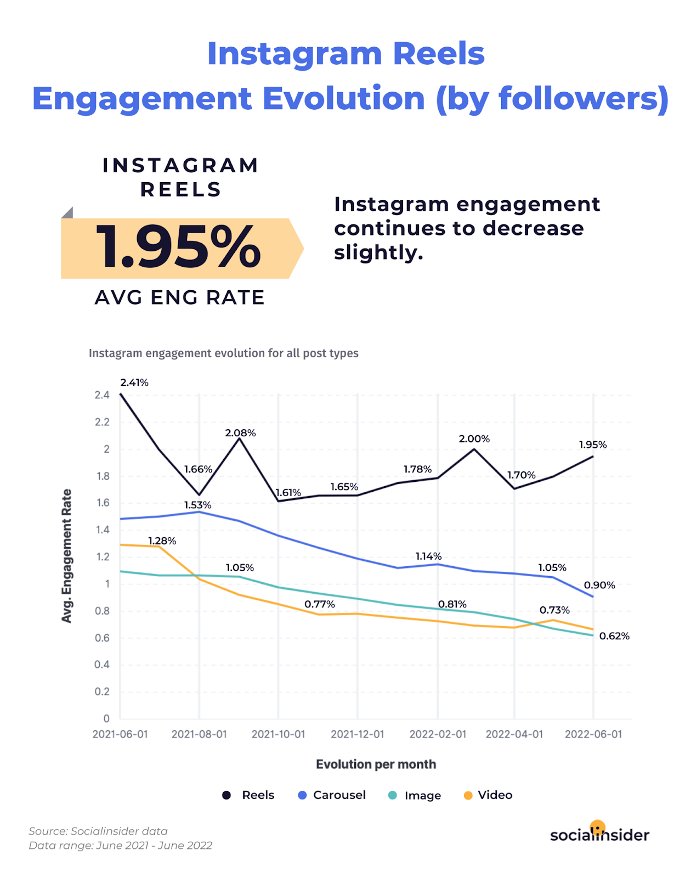
Instagram Engagement

Slide 11
How to Make a Reel in 5 Steps
Step 1: Tap the plus icon at the top of the page and select Reel
Step 2: Record or upload your video clip
Step 3: Edit your Reel
Step 4: Adjust your Reel’s settings
Step 5: Post your Reel

Slide 12
How to Make a Reel in 5 Steps
Step 1: Tap the plus icon at the top of the page and select Reel
To access Reels, simply open the Instagram app and head to your profile page. Click the plus sign button on the top right of the screen and select Reel.
You can also access the Reels editor by swiping left to the Instagram camera and selecting Reel from the bottom options.

Slide 13
How to Make a Reel in 5 Steps
Step 2: Record or upload your video clip
Instagram Reels gives you two options to create a Reel:
Press and hold the record button to capture footage.
Upload video footage from your camera roll.
Reels can be recorded in a series of clips (one at a time), or all at once.
If you set a timer early on, there’s a countdown before the hands-free recording starts.

Slide 14
How to Make a Reel in 5 Steps
Step 2: Record or upload your video clip
During the recording, you can tap the record button to end a clip, and then tap it again to start a new clip.
Then, the Align button will appear, allowing you to line up objects from the previous clip before recording your next. This allows you to create seamless transitions for moments like changing outfits, adding new music, or adding new friends to your Reel.
If you want to watch, trim, or delete the previous clip you recorded, you can tap Edit Clips.

Slide 15
How to Make a Reel in 5 Steps
Step 3: Edit your Reel
Once you’re done with recording, you can add stickers, drawings, and text to edit your Reel using the icons on the top of the editor.
The Reels editor features built-in creative tools so you can do all your editing from one interface.

Slide 16
How to Make a Reel in 5 Steps
Step 3: Edit your Reel
Here’s what each feature does:
Audio (1) lets you select audio from the Instagram music library or import it from your device and add it to your video. You can even choose to add your favorite part only.
Length (2) lets you change the length of your video. You can choose to make your video 15, 30, 60, or 90 seconds.
Speed (3) lets you change the speed of your video. Slow it down by choosing .3x or .5x or speed it up by choosing 2x, 3x, or 4x.

Slide 17
How to Make a Reel in 5 Steps
Step 3: Edit your Reel
Layout (4) lets you adjust the layout and add more than one recording to the frame.
Timer (5) lets you set a timer that will go off before you start recording and set a time limit for the next clip. This is useful if you want to record hands-free.
Dual (6) lets you record videos using your front and rear cameras at the same time.
Align (7) appears after you record your first clip. It allows you to line up objects from the previous clip.

Slide 18
How to Make a Reel in 5 Steps
Step 3: Edit your Reel
After you’ve aligned your clips, you can tap the music note icon to add trending sounds or music, or record a voiceover.
You can also tap the download icon to download Instagram Reels to your device to view or edit later.
For a full rundown on editing - https://blog.hootsuite.com/instagram-reels-tutorial/

Slide 19
How to Make a Reel in 5 Steps
Step 4: Adjust your Reel’s settings
When you’re ready, tap Next in the bottom right corner of your screen. You will be able to:
Edit your Reel cover. You can choose a frame from the video or add an image from your camera roll.
Add a caption.
Tag people in your Reel.
Add a location.

Slide 20
How to Make a Reel in 5 Steps
Step 4: Adjust your Reel’s settings
Enable Facebook recommendations. If you select this option, your Reel will be surfaced to Facebook users who are likely to enjoy your content (according to Meta’s algorithms). You don’t need a Facebook account to use this feature.
Rename your audio. If you add your own audio (e.g. a voice recording) to your Reel, you can give it a name that will show up in other users’ Reels if they decide to use the sound.
Enable or disable automatically generated captions.
Decide whether you want your Reel to be posted to your Instagram Feed (and not just the Reels tab on your account).

Slide 21
How to Make a Reel in 5 Steps
Step 5: Post your Reel
Once you adjust your settings, tap the Share button at the bottom of the screen.

Slide 22
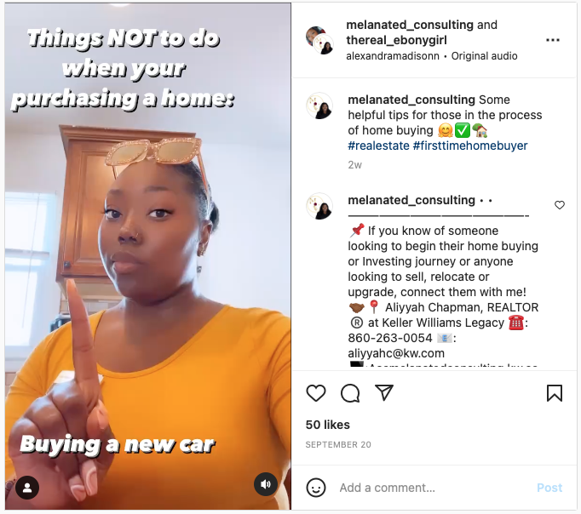
Realtor Ideas and Trends
Things you shouldn’t do when buying a house
  Getting a new job, considering a new credit card, moving money around etc…
https://www.instagram.com/reel/CivydIrjdgd/?igshid=YmMyMTA2M2Y=

Slide 23
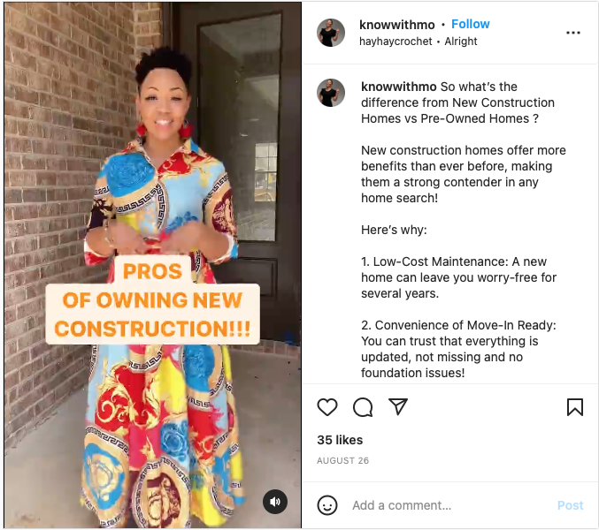
Realtor Ideas and Trends
Advantages of New Construction
  Low maintenance, customizable, move-in ready, modern design etc…
https://www.instagram.com/reel/ChuotWNttlp/?igshid=YmMyMTA2M2Y=

Slide 24
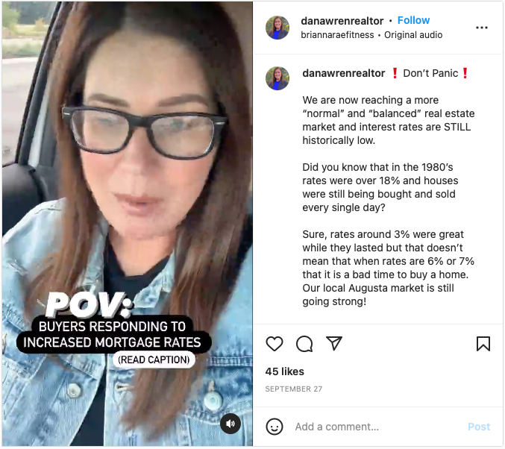
Realtor Ideas and Trends
POV: Buyers responding to increased mortgage rates
https://www.instagram.com/reel/CjAtW-UjSPU/?igshid=YmMyMTA2M2Y=

Slide 25
Realtor Ideas and Trends
Before & After
Before & afters are a great way to show the impact of your work. Plus, before & afters are inherently satisfying to watch! Think: a staged listing, a fresh paint job, or a home renovation.
Info-tainment
A great way to educate & engage your audience is by sharing informative & entertaining content – at the same time! Bust a common misperception, share information about mortgages, inventory, interest rates, or the benefits of staging a listing. Tip: Use a trending audio clip to reach new accounts.

Slide 26
Realtor Ideas and Trends
Local Spotlight
Spotlight local cafes, parks or neighborhoods to show what it’s like to live in your area. Grab a few clips of what a day in the life as a resident in your town looks like or spotlight specific neighborhoods. Remember to tag the establishments you visit, they are likely to re-share your posts with their audience – getting your content greater reach!
Relatable
Sharing relatable content is a great way to connect with other Realtors & potential clients. It lets your audience know you understand their experiences and allows you to build trust! Tip: scroll through Reels or Tiktok and ask yourself: “Is there a real estate spin I could take on this?”

Slide 27
Realtor Ideas and Trends
Quick Tip
Do you ever feel like you are answering the same questions for your clients repeatedly? Use this as an opportunity to create FAQ Reels. Some other ideas: tell us about the current housing market, share a real estate story or tip for sellers, buyers or other Realtors. Act as if you’re speaking to a friend!
Home Tutorial
Have a home trick up your sleeve? Now, how-to’s and tutorials are easier to create with Reels’ 90- second video limit. Think: tips for preparing for an open house or impactful updates to make before listing your home

Slide 28
Realtor Ideas and Trends
Day in the Life
Show the REAL behind your real estate business. Get authentic and personal with your audience to build their trust! Show how you start your mornings, how you spend your weekend, your favorite hobbies, or other parts of your life outside of real estate!

Slide 29
Realtor Tips, Tricks & Hacks
Here are a few tips to help your Reels.
Quality of Reel
    Shoot your Reels in 4K when you can. Instagram doesn’t deal with HD well.
    Turn on High Quality Upload Feature
      Go to your Instagram Profile and click settings
      Select Account
      Select Data Usage
      Click High Quality Uploads

Slide 30
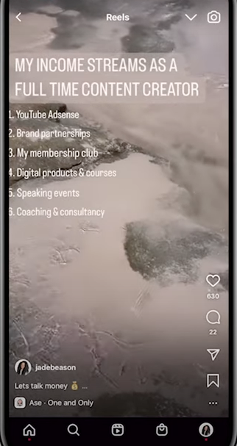
Realtor Tips, Tricks & Hacks
Get People to Rewatch
    The algorithm likes when your video gets multiple views, of course.
    One trick to getting views is putting lots of content on the screen
      Enough that the general user can’t read it all in one take.
      Stack lots of text (try bulleted list)

Slide 31
Realtor Tips, Tricks & Hacks
Use Advanced Captions
    People sometimes view Reels with their sound off or have hearing impediments
    Also, the Algorithm is looking at caption content for relevancy and topics
      Try using caption option 3. Scroll to third option.
      It allows you to have captions that show in an easy-to-read format.

Slide 32
Realtor Tips, Tricks & Hacks
Use Post Captions
    People rarely read the captions, but Instagram is. Also, super engaged users are reading the captions.
      Keep it relevant to your topic
      Use keywords that you think people would use to find your type of videos

Slide 33
Realtor Tips, Tricks & Hacks
Using Hooks to Keep Visitors on your Reel
    Users have about an 8 second attention span and when rolling through reels they will have seconds to decide to stay or go.
      Use words in the first few seconds of your Reel
      Hook them in with a topic you know they care about.

Slide 34
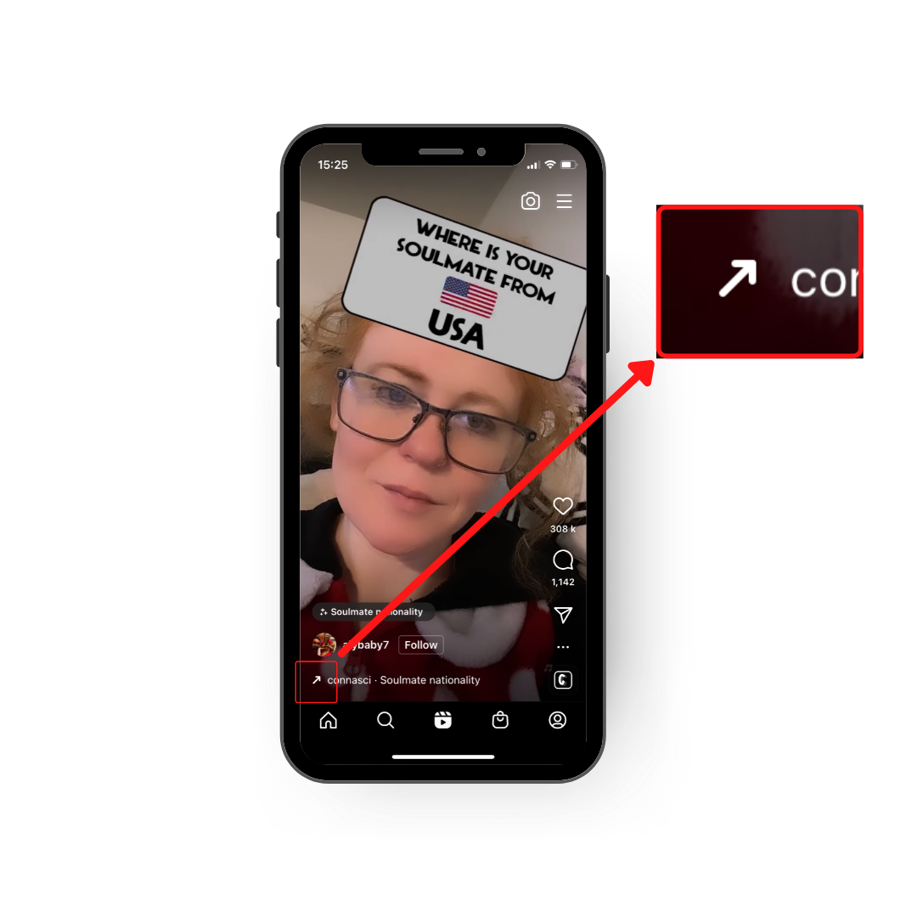
Realtor Tips, Tricks & Hacks
Trending Audio
    If you use audio that is popular Instagram will notice it and give your video a bump
      Go on Instagram and look at Reels. Be on the look out for the arrow on the left-hand side of the screen. This arrow is Instagram's way of indicating that this audio is on the rise and is considered a trend. Once you've identified the trending audio, save it for later by tapping on the audio file name and clicking “Save” at the top.

Slide 35
Realtor Tips, Tricks & Hacks
Converting Followers
    Content Library is crucial
    Start building videos in a niche. They don’t have to be the same TYPE of video they just have to cover a niche.
    Work on a schedule and have topics worked out (editorial schedule)

Slide 36
Instagram Reels Secret Weapon
There are a ton of apps, tools and ideas out there (we have links to some) for your social media but the most important thing you have is an editorial schedule.
It keeps you on track and helps formulate ideas.

Slide 37
THANK YOU

